Slide 1
Module-1:
BASICS OF C PROGRAMMING

Slide 2
Module-1: BASICS OF C PROGRAMMING :
Introduction to programming paradigms: Applications of C Language, Structure of C program
C programming: Data Types, Constants, Enumeration Constants, Keywords.
Operators: Precedence and Associativity, Expressions, Input/Output statements, Assignment statements, Decision making statements, Switch statement, Looping statements Preprocessor directives, Compilation process.

Slide 3
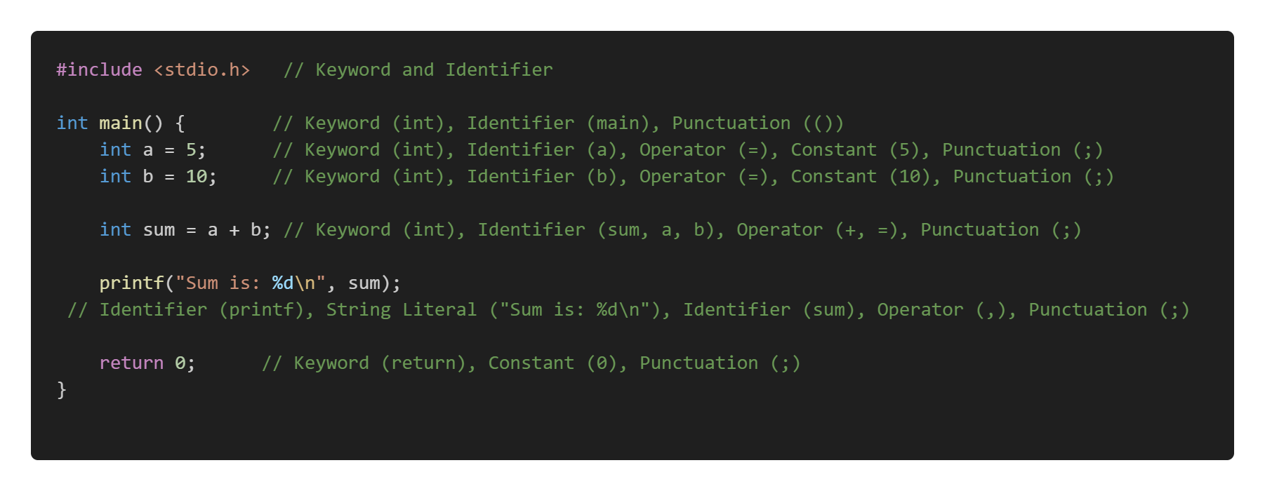
C Program Example:

Slide 4
C Tokens:
In C, tokens are the smallest units in a program that have meaningful representation. They are the building blocks of the language.
There are several types of tokens in C, which are categorized as follows:
Types of C Tokens
Keywords
Identifiers
Constants
Literals
Operators
Punctuation (Separators)

Slide 5
1. Keywords
Keywords are reserved words in C that have special meaning and cannot be used as identifiers (variable names, function names, etc.). Each keyword in C has a specific meaning and purpose in the program.
Examples of keywords: int, return, if, while, for, switch, void, break, continue, struct
Explanation:
int: Declares integer variables.
return: Exits from a function and optionally returns a value.
if, else: Conditional statements.
2. Identifiers
Identifiers are the names given to various program elements like variables, functions, arrays, and structures. An identifier must begin with a letter (a-z, A-Z) or an underscore (_), followed by letters, digits (0-9), or underscores.
Examples of identifiers: num, sum, average, totalAmount
Explanation:
Identifiers help in distinguishing different entities in a program.
They should not match any of the keywords.

Slide 6
3. Constants:
Constants represent fixed values in a program, which doesn’t change thought the life cycle of the Program
1. Integer Constants: These are whole numbers without decimals.
Example: 10, -5, 0
2. Floating-point Constants: These represent real numbers with decimals.
Example: 3.14, -0.5, 2.0
3. Character Constants: These represent single characters enclosed in single quotes.
Example: 'A', '1', ‘%’
4. String Constants: These represent a sequence of characters enclosed in double quotes.
Example: "Hello, World!"
Explanation:
Constants represent values that remain unchanged during program execution.
The type of the constant is determined by its form, such as integer, floating-point, or character.

Slide 7
4. Literals:
In C, literals refer to fixed values that are directly used in a program. They represent constant values used in the program and can be of various types. Example Values assigned to a variable int a =10;
The literal types in C include:
Integer Literals
Floating-point Literals
Character Literals
String Literals
Boolean Literals (C99 and later)
Void Pointer Literals (C99 and later)

Slide 8
5. Operators:
In C, operators are symbols used to perform operations on variables and values. Operators can be classified based on the number of operands they operate on. The main classifications are Unary, Binary, and Ternary operators.
Operators are symbols that perform operations on variables and values.
Example: +, -, *, =, ==, +=, --, ++ and so on.
6. Punctuation (Separators):
Punctuation marks (also called separators) are symbols used to separate different parts of a program, such as statements, declarations, and arguments.
Example: {}, [], (), ., /, :, and so on.

Slide 9
Programming Paradigms (Models):
Programming paradigms are foundational styles or approaches to programming that provide a way to structure and organize code. They define how problems are formulated and solved in programming.
Imperative Programming: Focuses on how a program operates.
Examples: C, Python (imperative style), Java.
Declarative Programming: Focuses on what the program should accomplish rather than how it is achieved.
Examples: SQL, HTML, Prolog.
Procedural Programming (How to Do): A subset of imperative programming that organizes code into reusable procedures or functions.
Examples: C, Pascal.
Functional Programming (What to Do): Treats computation as the evaluation of mathematical functions, avoiding changing state and mutable data.
Object-Oriented Programming (OOP): Models real-world entities using objects and classes. Examples: Java, C++, Python (OOP style).

Slide 10
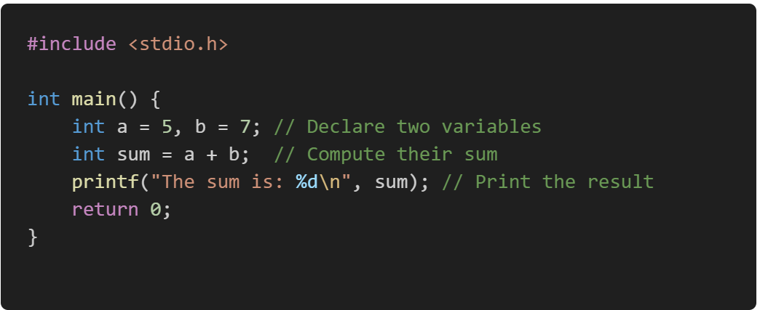
1. Imperative Programming:
Here we need to specify the exact sequence of steps or instructions that the computer must follow to achieve a desired result.
In an imperative programming style, the programmer provides detailed instructions to the computer, including how data is processed, modified, and stored.
Here is an example of summing the numbers imperatively:

Slide 11

2. Declarative Programming:
In declarative programming, you state what the program should do and let the underlying system handle how to achieve it.
Example in SQL:

Slide 12
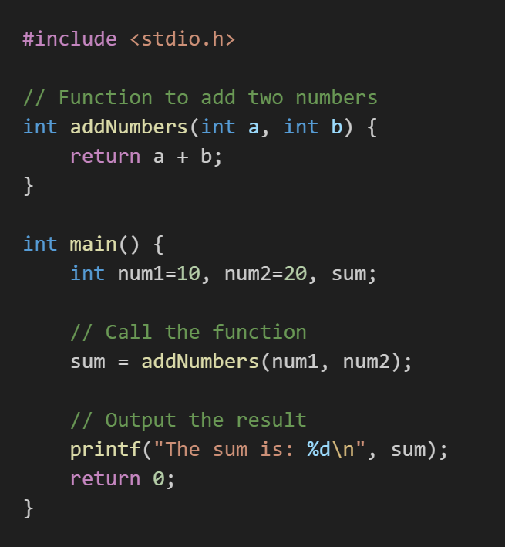
3. Procedural Programming (How to Do):
Procedural programming is a programming paradigm derived from imperative programming that emphasizes breaking down a program into procedures or functions.
These procedures are reusable blocks of code that perform a specific task. Procedural programming focuses on a sequence of instructions executed in a defined order to achieve a specific outcome.

Slide 13
Explanation: Why it is Procedural?
It organizes the solution into a sequence of steps (defining a Procedure, calling it, and printing the result).
It is procedural because:
It uses mutable variables (num1, num2, sum) to manage state.
Procedures (like addNumbers) are used to perform specific tasks.
Focuses on step-by-step execution.

Slide 14
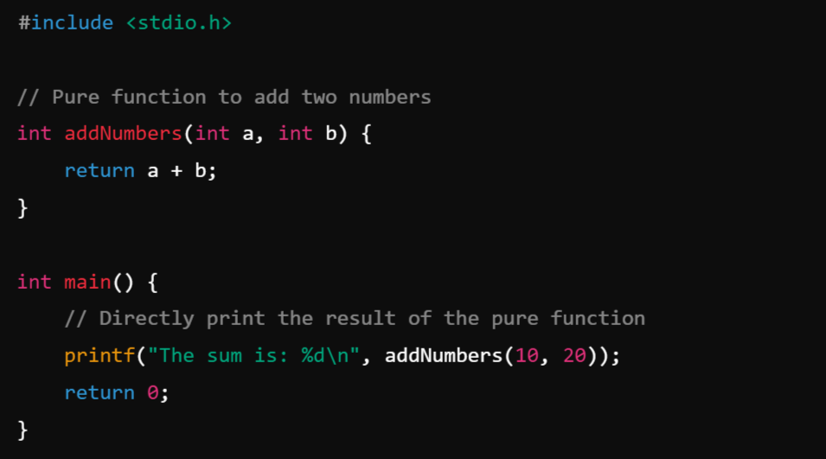
4. Functional programming (What to Do) :
Functional programming is a programming paradigm where computation is treated as the evaluation of mathematical functions, avoiding changing state and mutable data. It emphasizes what to do rather than how to do it, focusing on the use of pure functions, immutability, and function composition.
Example:
How to Convert Procedure to Function:
Avoid mutable variables.
Use pure functions and directly pass inputs and outputs without modifying any state.

Slide 15
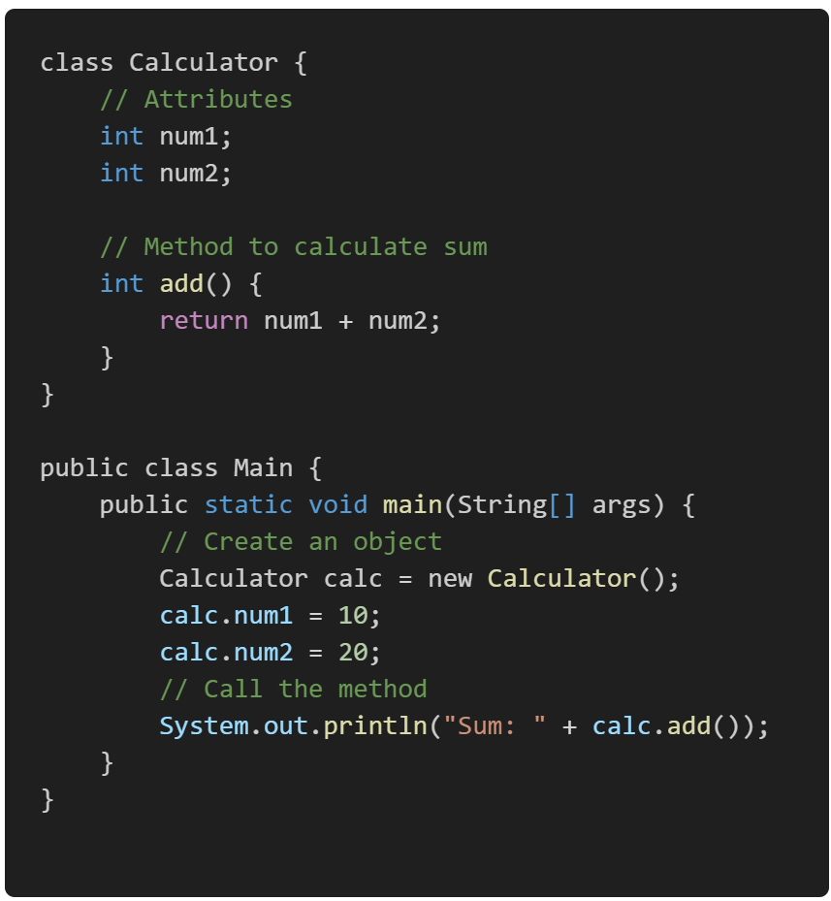
5. Object-Oriented Programming (OOP)?
Object-Oriented Programming (OOP) is a programming paradigm based on the concept of objects, which are instances of classes.
These objects encapsulate data (attributes) and behavior (methods), allowing for modular, reusable, and maintainable code.
OOP promotes the organization of code into real-world entities, making it easier to design complex systems.

Slide 16
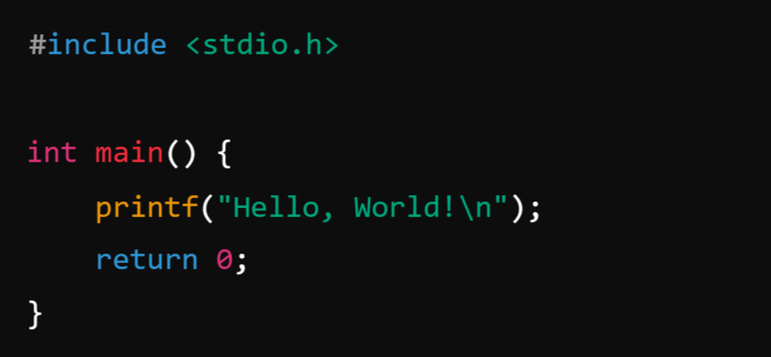
What is C Programming?
C is primarily classified as an imperative procedural programming language, but it also supports some features of other paradigms to a limited extent.
C was developed by Dennis Ritchie in the early 1970s at Bell Labs. It has had a profound influence on many programming languages and is still widely used today, especially in system programming, embedded systems, and operating systems development.
Here’s a simple C program that prints "Hello, World!" to the console:

Slide 17
What is Procedure?
A procedure in programming refers to a set of instructions or a block of code designed to perform a specific task or operation. Procedures are typically used to encapsulate functionality that can be reused in different parts of a program. In some programming languages, procedures are also called functions, methods, or subroutines.
Note:
No Return Value (in some languages): In some contexts, procedures do not return any value, unlike functions that usually return a result. Procedures are simply called to perform an action.
Encapsulation: A procedure encapsulates a specific set of instructions that perform a defined task. It allows you to avoid repeating the same code and makes your program more modular and organized
Parameters (Optional): A procedure can take input parameters, which allow you to pass data to the procedure. These parameters help the procedure perform its task dynamically based on the input.
Reusability: Once a procedure is defined, you can call it as many times as needed without rewriting the code.

Slide 18
Types of Procedures:
1. Void Procedure (No Return Value):
A Void Procedure is a procedure that performs an operation but does not return any value. It may perform an action like printing a result or modifying some data.
Example: Add Two Numbers and Print the Result (Void Procedure)
2. Function Procedure (Returns a Value)
A Function Procedure is a procedure that returns a value after performing its task. The value could be any type, such as an integer, float, string, etc.
Example: Add Two Numbers and Return the Result (Function Procedure)

Slide 19
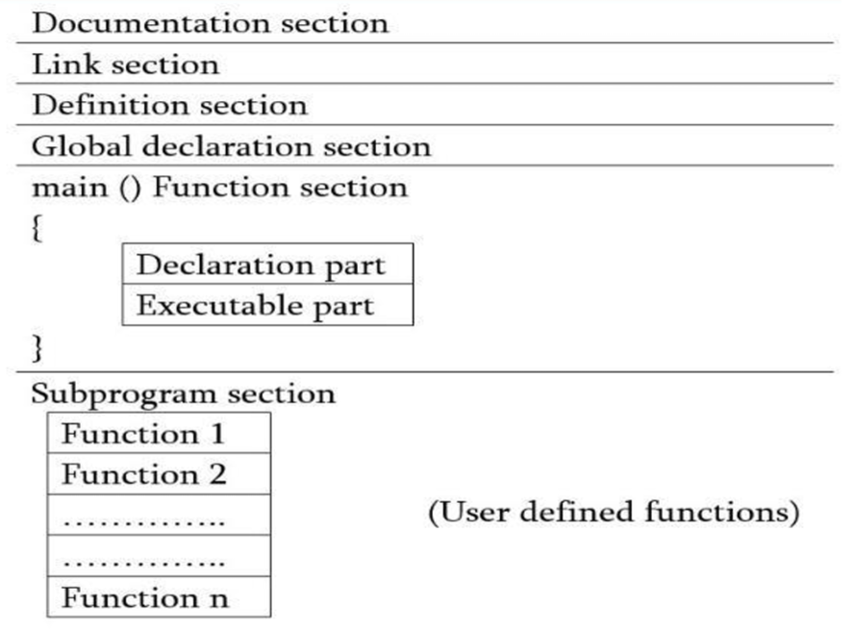
Structure of C program:
The structure of a C program generally follows a specific order of components to ensure proper execution and clarity. Here's an outline of the basic structure:
Basic Structure of a C Program:
Documentation Section
Link Section or Preprocessor Directives
Definition Section
Global Declarations
Function Declarations or Prototype
Main Function
Function Definitions

Slide 20
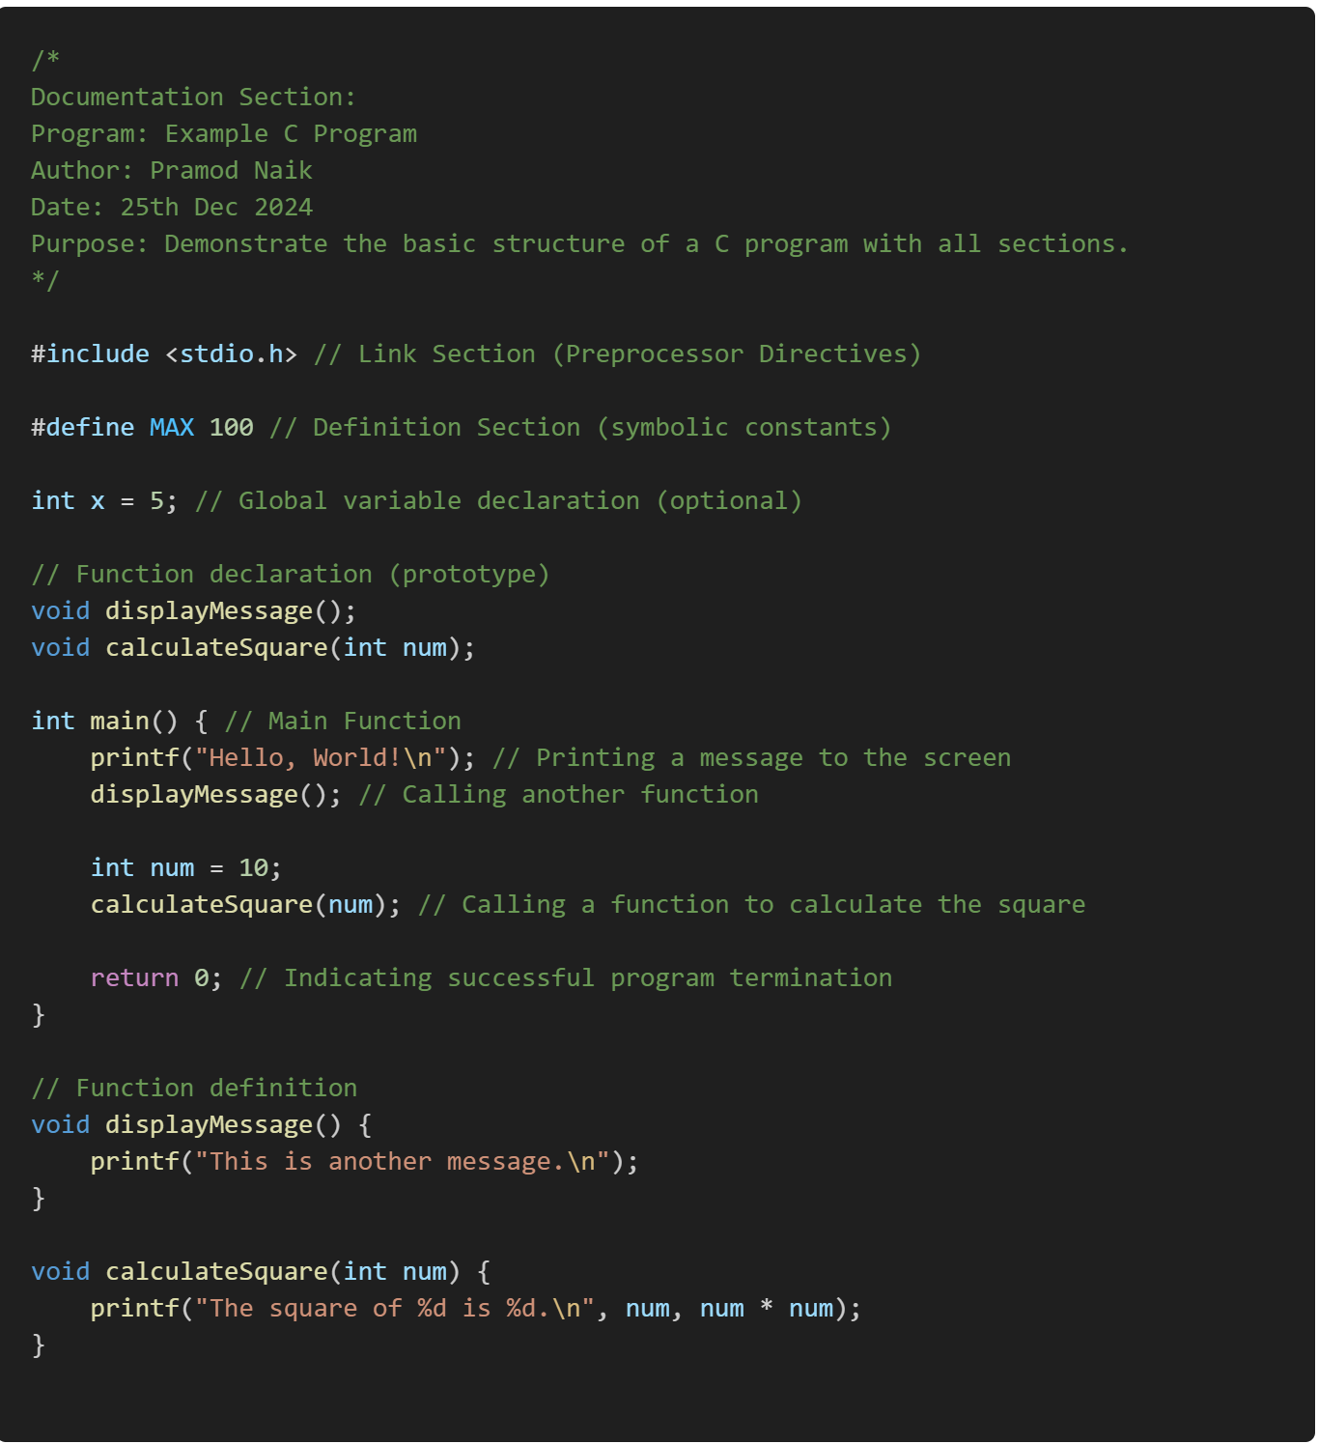
Example:
Structure of C Program

Slide 21
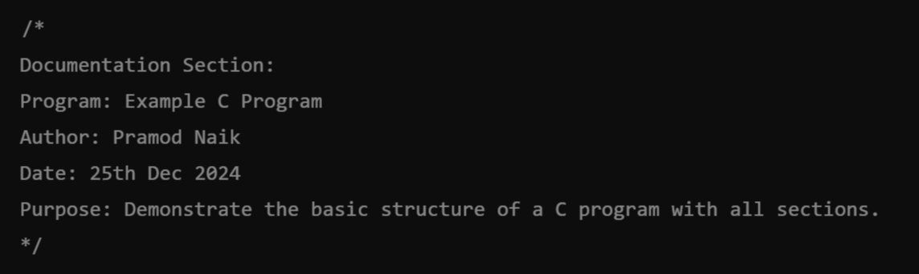
1. . Documentation Section:
The documentation section consists of a set of comment lines giving the name of the program, the author and other details, which the programmer would like to use later.
This is where comments about the program are added, such as its purpose, author, date, and other metadata.
Example:

Slide 22
2. Preprocessor Directives or Link Section:
These are used to include external files, libraries, or to define constants. Preprocessor directives start with #, and they are processed before the actual compilation of the code begins.
Includes headers and macros for external libraries or preprocessor directives.
The link section provides instructions to the compiler to link functions from the system library such as using the #include directive.
Example:

Slide 23
3. Definition Section:
The definition section defines all symbolic constants such using the #define directive.
Used for defining symbolic constants and macros, often part of preprocessor directives.
Example:

Slide 24

4. Global Declarations:
There are some variables that are used in more than one function. Such variables are called global variables and are declared in the global declaration section that is outside of all the functions.
This section is optional. If your program requires global variables or function declarations, they are declared here.
Example:

Slide 25
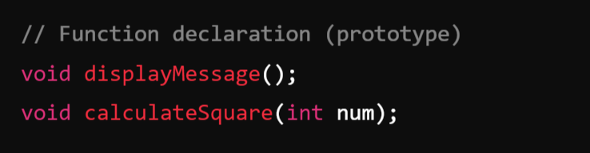
5. Function Declarations or Prototypes:
Declare the functions used in the program. This informs the compiler about the function's name, return type, and parameters.
This is very important if you define your function after the main() method such that compiler need to know the prototype or declaration of your function before starting executing main method.
Example:

Slide 26
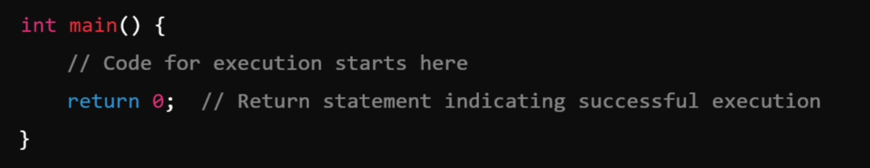
6. Main Function:
The main() function is where the program starts executing. Every C program must have one main() function.
Note: In the C program, return 0; in the main function indicates that the program has successfully executed without any errors.
When the program reaches return 0;, it ends the main() function and sends the value 0 back to the operating system. This is known as the exit status of the program, which is typically used by the operating system or the calling process to determine whether the program ran successfully.
If you had return 1; instead of return 0;, it would indicate an error in the program. In such cases, the program might exit with a non-zero status to indicate a failure.

Slide 27
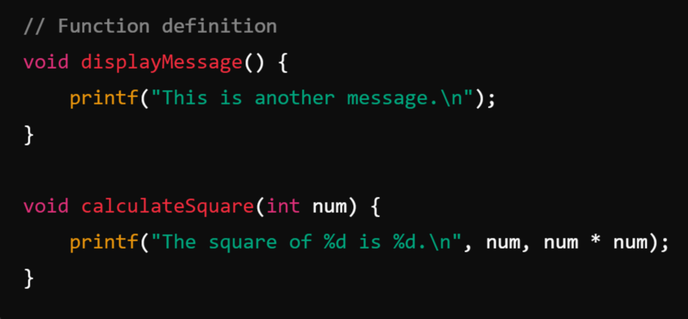
7. Function Definitions:
Functions may be declared and defined either before or after main(). These are optional unless your program requires additional logic beyond the main() function.
Example:
Note:
In C, function declarations (also known as function prototypes) should be placed before the main() function or any other function that calls them. This ensures that the compiler knows about the function's signature (name, return type, and parameters) before it is used in the program.

Slide 28

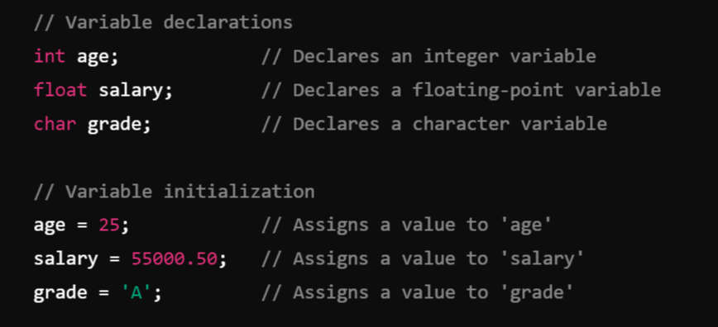
Variable: ( Name given to the memory location):
A variable is a named location in memory that stores data that can be modified during program execution. A variable is used to represent data that the program can manipulate.
Syntax for Declaring Variables:
Example:
data_type: Specifies the type of data the variable will hold (e.g., int, float, char).

Slide 29
Note:
Each variable in C has an associated data type. It specifies the type of data that the variable can store like integer, character, floating, double, etc. Each data type requires different amounts of memory and has some specific operations which can be performed over it.

Slide 30
Data Types:
In C, data types define the type of data a variable can hold. They are crucial for memory management, as they specify the amount of memory to be allocated and the operations that can be performed on the data.
Data types are broadly classified into primitive (basic) and non-primitive (derived or user-defined) data types based on their complexity and usage.
ANSI C provides three types of data types:
Primitive(Built-in) Data Types
Derived Data Types
User Defined Data Types

Slide 31
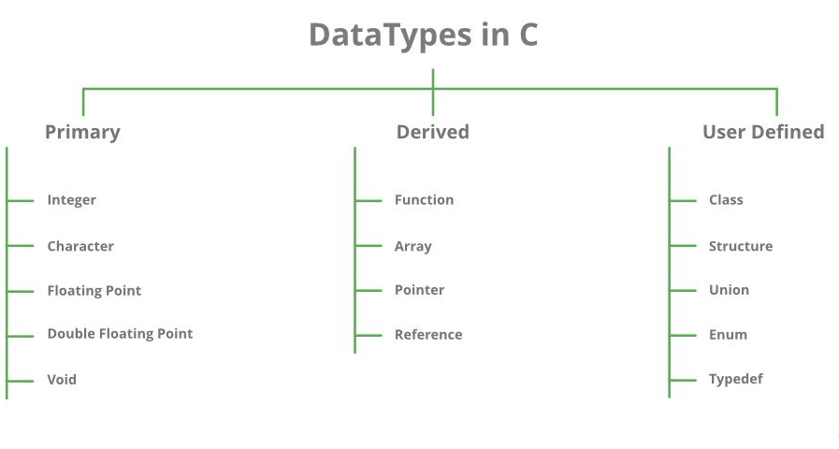


Slide 32
Primitive(Built-in) Data Types: Primitive Data types are defined by the language itself.
Primitive data types in C are the basic building blocks of data manipulation in the language. They are predefined by the compiler and provide a means to store simple values.
Integer:
The integer data type in C is used to store whole numbers (numbers without a fractional or decimal component). These numbers can be positive, negative, or zero.
Signed and Unsigned:
Signed integers can store both positive and negative values.
Unsigned integers store only non-negative values, effectively doubling the maximum positive range.
Variations:
short: Smaller range, typically 2 bytes.
long: Larger range, typically 4 or 8 bytes.
long long: Very large range, typically 8 bytes.

Slide 33
Variations of Integer Type:
Type | Size (bytes) | Range (Signed) : n = size * 8 Minimum Value = −2^{n−1} Maximum Value = 2^{n−1} −1 | Range (Unsigned) Minimum Value = 0 Maximum Value = 2^{n} −1
int | 4 | -2,147,483,648 to 2,147,483,647 | 0 to 4,294,967,295
short int | 2 | -32,768 to 32,767 | 0 to 65,535
long int | 4 or 8 | -2,147,483,648 to 2,147,483,647 | 0 to 4,294,967,295 (or higher)
long long int | 8 | -9,223,372,036,854,775,808 to 9,223,372,036,854,775,807 | 0 to 18,446,744,073,709,551,615

Slide 34
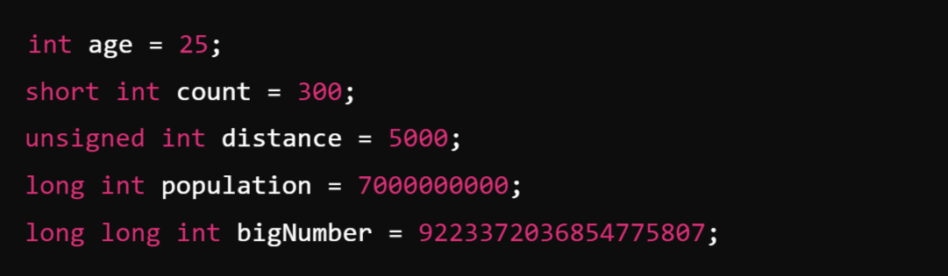
Example:

Slide 35
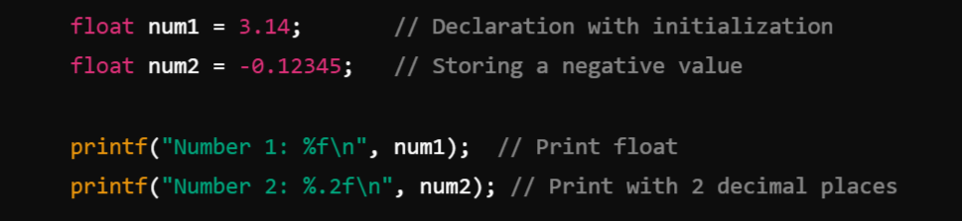
2. Floating Point:
The float data type in C is used to represent real numbers (numbers with fractional parts) in single precision. It is a primary data type that allows storing values with decimal points.
Storage Size:
Typically, 4 bytes (32 bits) on most systems.
The size can vary depending on the platform and compiler.
Example:

Slide 36
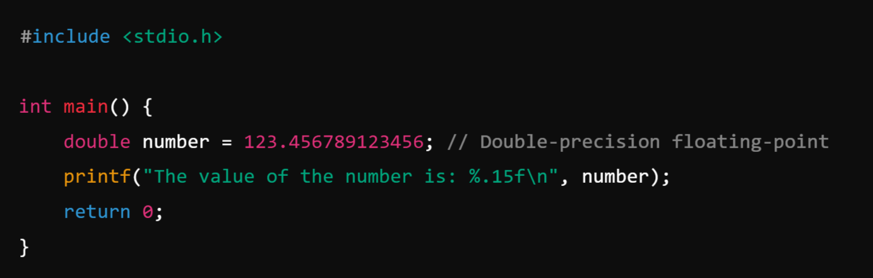
3. Double Floating Point:
Double Floating Point in C refers to a floating-point data type represented with 64 bits (8 bytes) of memory, offering double the precision of the standard float type.
Precision refers to the level of accuracy or detail with which a number is represented or stored in a computer. It determines how many significant digits a number can have.
Example:

Slide 37
Single Precision v/s Double Precision

Slide 38
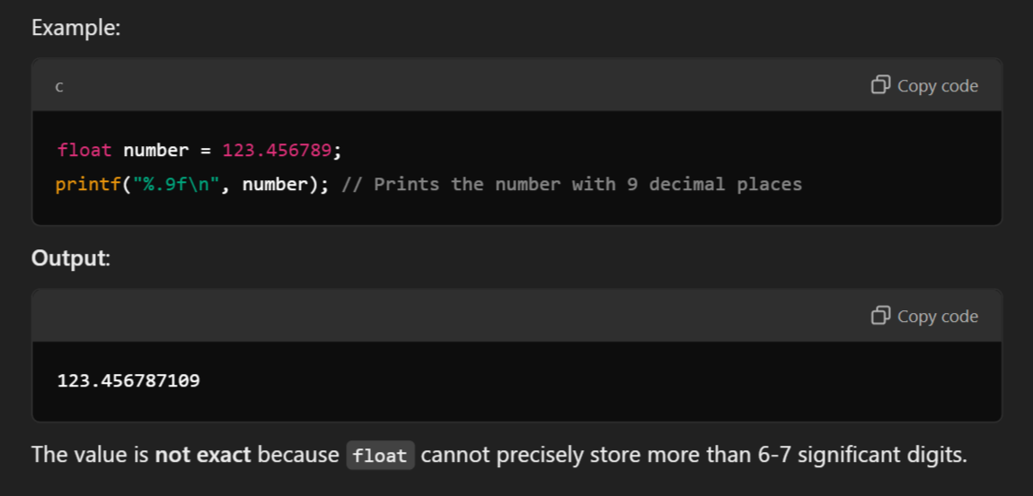
Single Precision (float):
Uses 4 bytes (32 bits).
Can represent numbers with approximately 6-7 significant decimal digits.

Slide 39
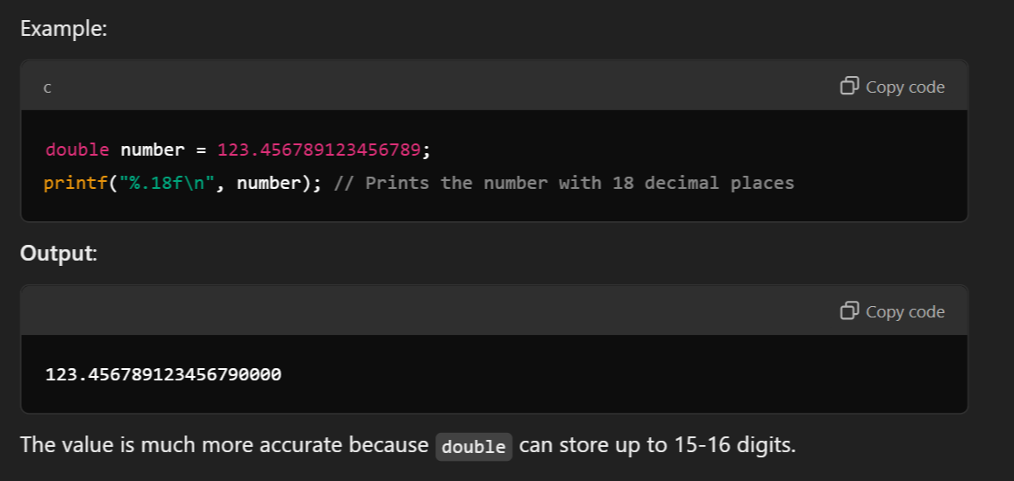
Double Precision (double):
Uses 8 bytes (64 bits).
Can represent numbers with approximately 15-16 significant decimal digits

Slide 40
4. Character:
The character data type (char) in C is used to store a single character. It is one of the primary data types and plays an imp
Key Points:
Size:
Typically takes 1 byte (8 bits) of memory.
Can store 256 different values (ranging from -128 to 127 for signed, or 0 to 255 for unsigned).
Purpose:
Represents single characters like letters, digits, and symbols (e.g., 'A', '1', '#').
Internally, the character is stored as an integer ASCII code.
Type Modifiers:
signed char: Stores values from -128 to 127.
unsigned char: Stores values from 0 to 255. ortant role in handling text and character data in programs.

Slide 41
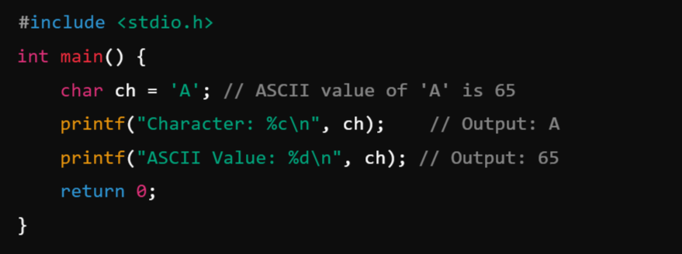
Example:

Slide 42
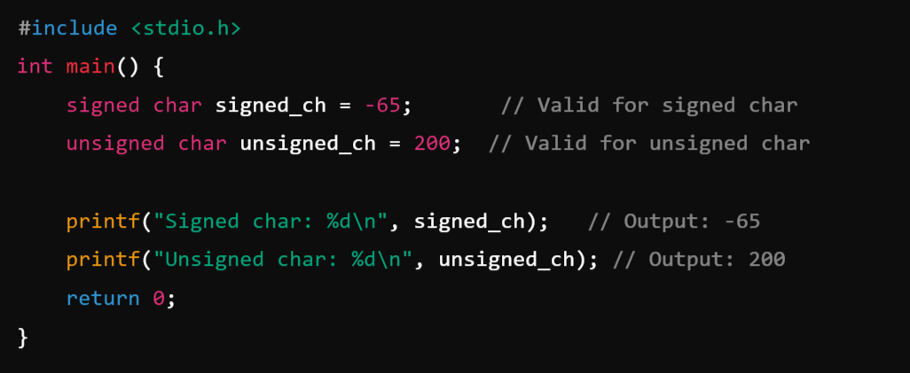
Example: Signed vs Unsigned

Slide 43
5. void:
The void data type in C represents the absence of any value or type. It is primarily used in situations where a function or pointer does not return or store any specific value.
Key Characteristics:
No Value:
A void type cannot hold any data or value.
It is often used to signify "nothing" or "no type."
Purpose:
Used as a function return type for functions that don't return any value.
Used in void pointers for storing addresses of variables of any type.

Slide 44
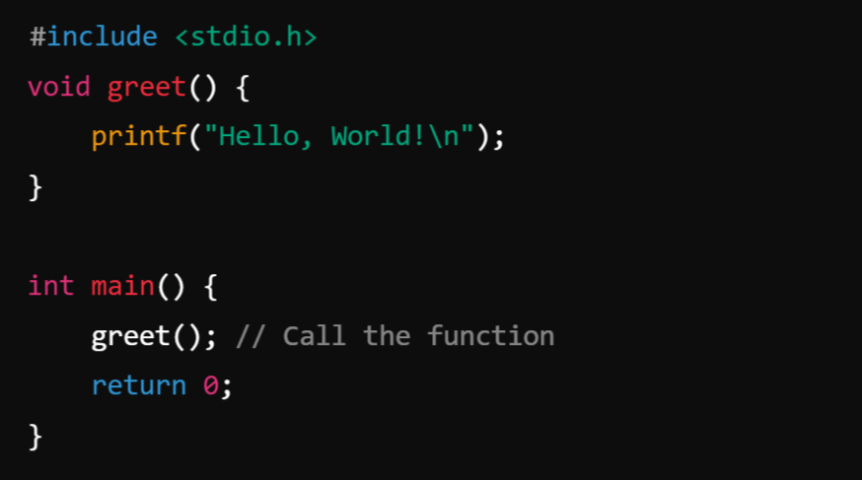
Example: A function declared with a void return type doesn't return any value to the calling function.

Slide 45
Derived Data Types in C
In C, the data types derived from the primitive or built-in data types are called Derived Data Types. In other words, the derived data types are those data types that are created by combining primitive data types and other derived data types.
There are 4 derived data types available in C. They are as follows:
Function
Array
Pointer
Reference

Slide 46

1. Function:
In C, functions are blocks of code designed to perform a specific task. Functions promote modularity, reusability, and readability in a program. They allow you to write the code once and use it multiple times.
Parts of a Function: A function in C consists of:
Function Declaration (Prototype):
Specifies the function's name, return type, and parameters.
Helps the compiler ensure the correct usage of the function.
Syntax:
Example:

Slide 47
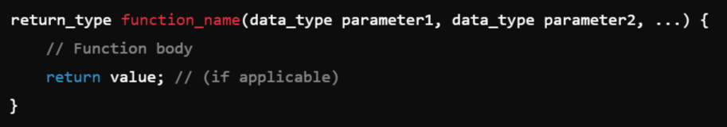
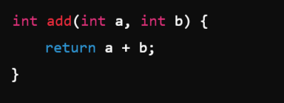
2. Function Definition:
Contains the actual code (body) that performs the task.
Syntax:
Example:

Slide 48

3. Function Call:
Invokes the function to execute its code.
Syntax:
Example:

Slide 49
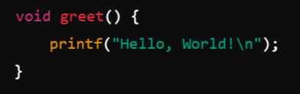
Types of Functions:
1. Pre-defined or Library Functions:
Predefined functions provided by C's standard library.
Examples:
printf() (for output)
scanf() (for input)
sqrt() (from math.h for square root)
2. User-Defined Functions:
Functions created by the programmer for specific tasks.
Example:

Slide 50
Array:
In C, an array is a collection of elements of the same data type stored in contiguous memory locations. Arrays allow you to store multiple values in a single variable, making it easier to work with related data.
Key Characteristics of Arrays:
Fixed Size:
The size of an array is defined at the time of its declaration and cannot be changed during runtime.
2. Homogeneous Elements:
All elements in an array must be of the same data type (e.g., all integers, all floats, etc.).
3. Contiguous Memory:
Array elements are stored in adjacent memory locations.
4. Indexing:
Array elements are accessed using indices, starting from 0.

Slide 51


Syntax of Array Declaration:
data_type: The type of elements stored in the array (e.g., int, float, char).
array_name: The name of the array.
size: The number of elements the array can hold.
Example-1:
Example-2: initialize an array while declaring it

Slide 52

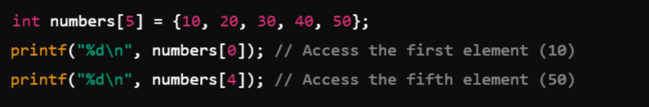
Accessing Array Elements
Array elements are accessed using their index in square brackets ([]).
Syntax:
Example:

Slide 53


3. Pointer:
In C, a pointer is a variable that stores the memory address of another variable. Pointers are one of the most powerful features of the C language, allowing direct access to and manipulation of memory locations.
Syntax:
Example:
data_type: Type of the variable that the pointer will point to.
*: Indicates that the variable is a pointer.
pointer_name: Name of the pointer variable.

Slide 54
User Defined Data Types:
The data types defined by the user themself are referred to as user-defined data types. These data types are derived from the existing datatypes.
There are 4 types of user-defined data types in C. They are
Structure
Union
Enum
Typedef

Slide 55
1. Structure:
A structure in C is a user-defined data type that allows you to group different types of variables under a single name. Structures are particularly useful for organizing related data together, such as information about an entity like a student, employee, or product.
As we know, C doesn't have built-in object-oriented features like C++ but structures can be used to achieve encapsulation to some level.
Why Use Structures?
To group variables of different types.
To create a complex data type that is easy to manage and use.
To model real-world entities in a program.

Slide 56
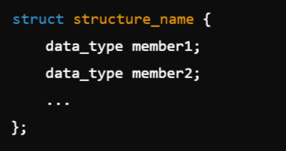
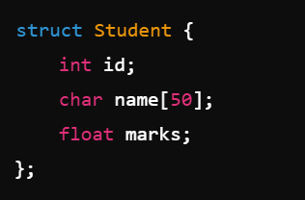
Defining a Structure
The struct keyword is used to define a structure.
Syntax:
Example:
structure_name: Name of the structure.
member1, member2, ...: Variables (members) of the structure.

Slide 57

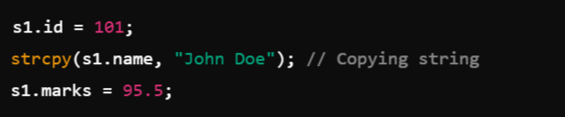
Using Structures:
Declaring a Structure Variable: Once a structure is defined, you can declare variables of that type:
Accessing Members: Use the dot operator (.) to access structure members.

Slide 58
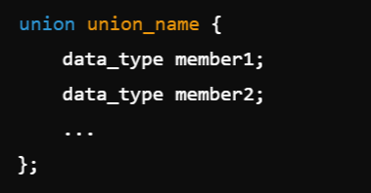
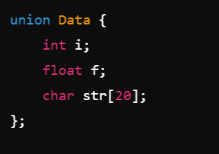
Union:
A union in C is a user-defined data type similar to a structure, but with a key difference: all members of a union share the same memory space. This means that only one member can hold a value at any given time. The size of a union is determined by the size of its largest member.
Unions are useful when you want to store different types of data in the same memory location, but only one piece of data is active at a time.
Syntax: Example:

Slide 59
Features of Union:
Shared Memory: All members share the same memory location.
Overwriting: Writing to one member overwrites the values of all other members.
When you write to one member of a union, the previous values of all other members are lost because all members of the union share the same memory location. Writing a new value overwrites the shared memory, making the previous values of other members inaccessible or unpredictable.
Unpredictable Results: Accessing a member after another member has been modified results in garbage or undefined values.

Slide 60
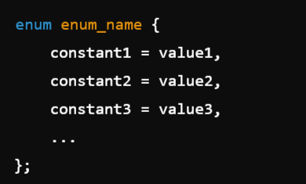
3. Enums:
An enum (short for enumeration) in C is a user-defined data type that consists of a set of named integer constants. It allows you to assign meaningful names to integer values, which makes the code more readable and manageable.
The "enum" keyword is used to declare an enumeration.
Syntax:
enum_name: The name of the enum type.
constant1, constant2, constant3, ...: The named constants (enumerators).
value1, value2, value3, ...: The corresponding integer values assigned to the constants. If not specified, C assigns consecutive integer values starting from 0.

Slide 61
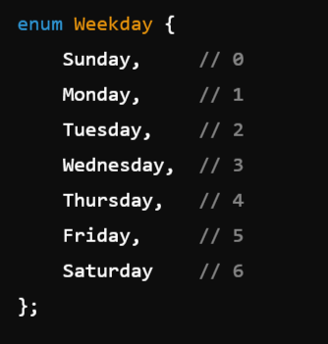
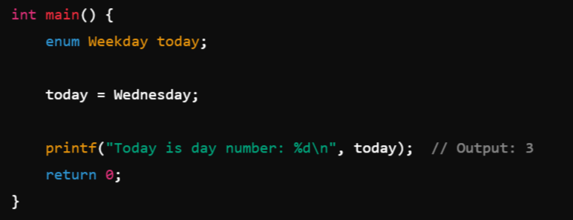
Example:
Here the values of the enumerators (Sunday, Monday, etc.) are automatically assigned starting from 0.
Thus:
Sunday = 0
Monday = 1
Tuesday = 2
and so on.

Slide 62
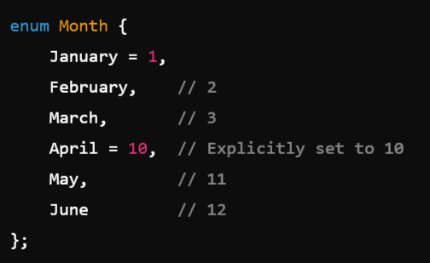
Example-2:

Slide 63

4. Typedef:
typedef is a keyword in C that allows you to create alias names (or new names) for existing data types.
It does not create new types but rather makes the code more readable by providing an alternative, often shorter, name for a data type.
Syntax:
existing_type: The type you want to create an alias for (e.g., int, struct, pointer).
new_type_name: The new name that you want to associate with the existing type.

Slide 64
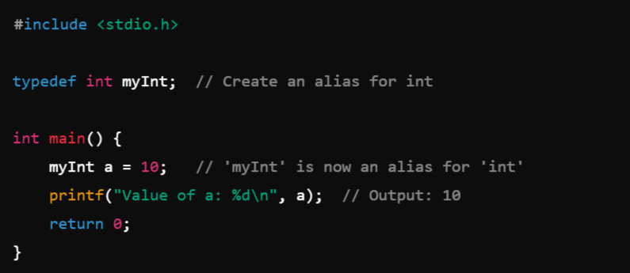
Example:

Slide 65
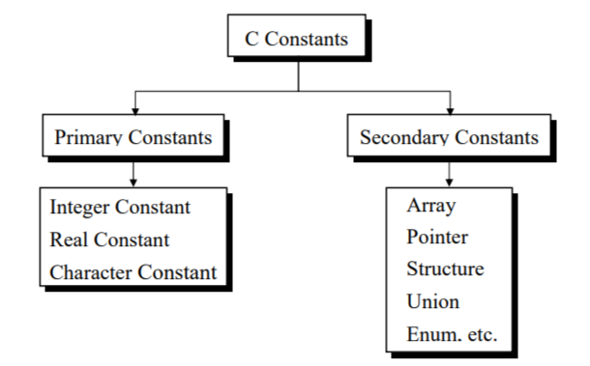
Constants in C
In C, a constant is a value that cannot be altered during the execution of the program. Constants are used to represent fixed values that are not supposed to change. They improve code readability, maintainability, and prevent accidental modification of important values.
There are different types of constants in C, such as literal constants, symbolic constants, enumeration constants, and macro constants.

Slide 66
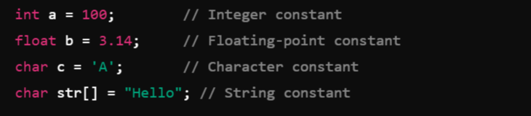
1. Primary Constants or Literal Constants:
Literal constants are fixed values that are directly written in the code.
Integer constants: These are whole numbers without decimal points.
Floating-point constants: These represent numbers with decimal points.
Character constants: These are single characters enclosed in single quotes (' ').
String constants: These are sequences of characters enclosed in double quotes (" ").
Example:

Slide 67

2. Symbolic Constants:
Symbolic constants are constants defined using the #define preprocessor directive. They are useful for representing fixed values that might change, so defining them as constants makes your code more maintainable.
Syntax:

Slide 68
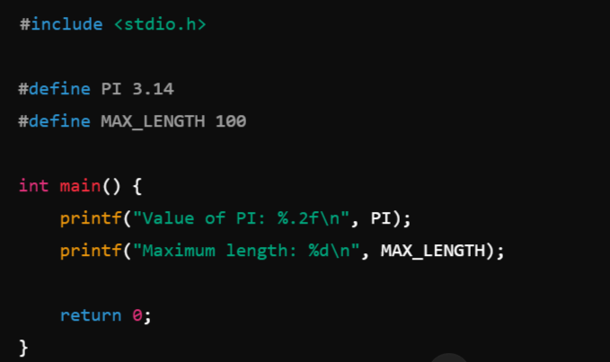
Example:

Slide 69


3. const Keyword Constants:
The const keyword in C allows you to declare variables whose value cannot be changed once they are initialized. These constants behave like regular variables, except their values cannot be altered after initialization.
Syntax:
Example:

Slide 70
4. Enumeration Constants:
An enum (enumeration) in C is a special type of constant that groups related constants together. Enums provide a set of named integer constants.
An enum (short for enumeration) in C is a user-defined data type that consists of a set of named integer constants. It allows you to assign meaningful names to integer values, which makes the code more readable and manageable.
The "enum" keyword is used to declare an enumeration.
Syntax:
enum_name: The name of the enum type.
constant1, constant2, constant3, ...: The named constants (enumerators).
value1, value2, value3, ...: The corresponding integer values assigned to the constants. If not specified, C assigns consecutive integer values starting from 0.

Slide 71
Example:
Here the values of the enumerators (Sunday, Monday, etc.) are automatically assigned starting from 0.
Thus:
Sunday = 0
Monday = 1
Tuesday = 2
and so on.

Slide 72
Example-2:

Slide 73
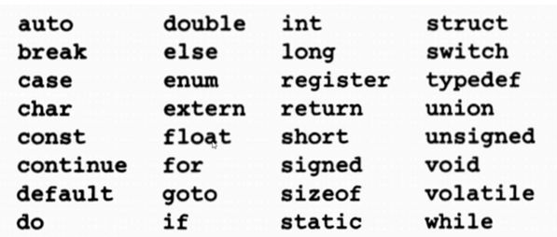
Keywords:
In C programming, keywords are reserved words that have special meanings and cannot be used as identifiers (such as variable names, function names, etc.).
These words are predefined by the C language and have specific functionality that is understood by the compiler. Keywords are an essential part of the C language and form the basic building blocks of the syntax.
Example: 32 Keywords

Slide 74
Operators in C:
In C, an operator is a symbol that performs operations on one or more operands. Operands are the values on which the operator operates. Operators are used to manipulate data and variables.
C supports various types of operators, including:
Unary Operators: An operator which operates on only 1 operand is called Unary.
Binary Operators: An operator which operates on 2 operands is called Binary
Arithmetic Operators
Relational Operators
Logical Operators
Assignment Operators
Bitwise Operators
Ternary Operator: An operator which operates on 3 operand is called Ternary.

Slide 75
Unary Operators: Which operates on only one Operand.
Operator | Description | Example ( a is a variable here)
+ | Unary plus, indicates a positive value. | +a
- | Unary minus, negates the expression. | -a
++ | Increment operator, increases the value by 1. | a++, ++a
-- | Decrement operator, decreases the value by 1. | a--, --a
! | Logical NOT, inverts the value of a boolean. | !true

Slide 76
2. Binary Operators: Operates on two operands
1. Arithmetic Operators: int a = 10; int b = 20
Operator | Description | Example
+ | Addition, adds two operands. | a + b
- | Subtraction, subtracts the second operand from the first. | a - b
* | Multiplication, multiplies two operands. | a * b
/ | Division, divides the numerator by the denominator. | a / b
% | Modulus, returns the remainder of the division. | a % b

Slide 77
2. Relational Operators:
Relational operators in C are used to compare two values and return a boolean result (true or false). int a = 10; int b = 20
Operator | Description | Example
== | Equal to, checks if two operands are equal. | a == b
!= | Not equal to, checks if two operands are not equal. | a != b
> | Greater than, checks if the left operand is greater than the right. | a > b
< | Less than, checks if the left operand is less than the right. | a < b
>= | Greater than or equal to, checks if the left operand is greater than or equal to the right. | a >= b
<= | Less than or equal to, checks if the left operand is less than or equal to the right. | a <= b

Slide 78
3. Logical Operators:
Logical operators in C are used to perform logical operations on boolean expressions. They are commonly used in conditional statements to combine multiple conditions. int a = 10; int b = 20
Operator | Description | Example
&& | Logical AND, returns true if both operands are true. | cond1 && cond2 (a>b) &&(a==10)
|| | Logical OR, returns true if any one of the operand is true. | cond1 || cond2 (a>b) || (a==10)
! | Logical NOT, inverts the value of a boolean operand. | !a

Slide 79
4. Assignment Operators: int a = 10; int b = 20
Operator | Description | Example
= | Simple assignment, assigns the right operand to the left operand. | a = b
+= | Addition assignment, adds right operand to left operand and assigns the result to the left operand. | a += b
-= | Subtraction assignment, subtracts right operand from left operand and assigns the result to the left operand. | a -= b
*= | Multiplication assignment, multiplies right operand with left operand and assigns the result to the left operand. | a *= b
/= | Division assignment, divides left operand by right operand and assigns the result to the left operand. | a /= b
%= | Modulus assignment, calculates modulus using two operands and assigns the result to the left operand. | a %= b

Slide 80
5. Bitwise Operators:
Bitwise operators in Java perform bit-level operations on integer types (int, long, short, char, byte). These operators work directly on the binary representation of numbers.
Operator | Description | Example
& | Bitwise AND, performs a bitwise AND operation. | a & b
| | Bitwise OR, performs a bitwise OR operation. | a|b
^ | Bitwise XOR, performs a bitwise XOR operation. | a ^ b
~ | Bitwise NOT, inverts all the bits of the operand. | ~a
<< | Left shift, shifts the bits of the left operand left by the number of positions specified by the right operand. | a << b
>> | Right shift, shifts the bits of the left operand right by the number of positions specified by the right operand. | a >> b
>>> | Unsigned right shift, shifts zero into the leftmost bits. | a >>> b

Slide 81
Truth Table:
&
2. |
3. ~
4. ^
A | B | A & B
0 | 0 | 0
0 | 1 | 0
1 | 0 | 0
1 | 1 | 1
A | !A
0 | 1
1 | 0
A | B | A | B
0 | 0 | 0
0 | 1 | 1
1 | 0 | 1
1 | 1 | 1
A | B | A | B
0 | 0 | 0
0 | 1 | 1
1 | 0 | 1
1 | 1 | 0

Slide 82
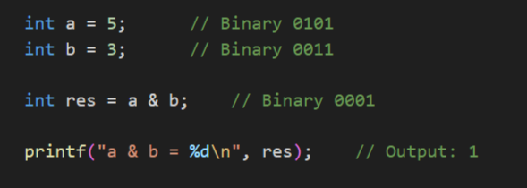
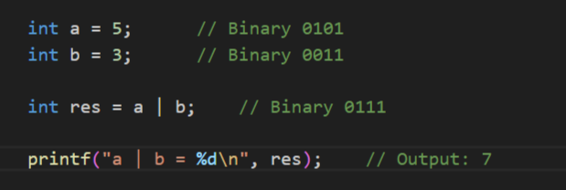
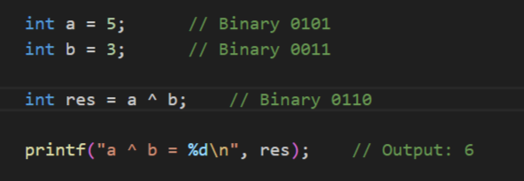
Example:
&
|
^

Slide 83

3. Ternary Operator
The ternary operator in C, also known as the conditional operator, is a shorthand for an if-else statement. It has three operands and is used to evaluate a condition and return one of two values, depending on whether the condition is true or false.
Syntax:
Where,
condition: This is a boolean expression that evaluates to either true or false.
expression1: This is the value returned if the condition is true.
expression2: This is the value returned if the condition is false.

Slide 84
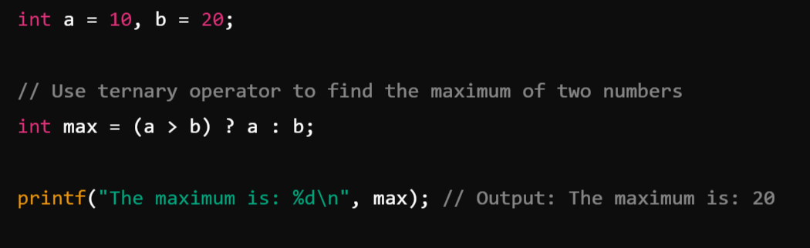
Example:

Slide 85
Expressions:
An expression is a combination of operators, constants and variables. An expression may consist of one or more operands, and zero or more operators to produce a value.
An expression in C is a construct that combines variables, operators, method calls, and literals to produce a single value.
Examples:
int number = 5;
int sum = 10 + 5;
boolean result = 10 > 5;
boolean result = (10 > 5) && (3 < 8);
int bitwiseAnd = 5 & 3;
int max = Math.max(10, 20);
boolean isString = "Hello" instanceof String;
int result = a + b * (a - 3) / 2;

Slide 86
Precedence and Associativity
Operator Hierarchy

Slide 87
Precedency: (Priority)
Precedence or Hierarchy refers to the order in which operators are evaluated in an expression when there are multiple operators present. So, it determines the order in which operators are evaluated in an expression. Operators with higher precedence are evaluated before operators with lower precedence.
Associativity:
Associativity defines the direction in which operators of the same precedence level are evaluated in an expression. If operators have the same precedence, their associativity determines the order of evaluation.
Associativity can be either:
1. Left-to-Right Associativity: Operators are evaluated from left to right. This is common for most operators.
For example, in the expression a - b - c, subtraction is evaluated as (a - b) - c.
2. Right-to-Left Associativity: Operators are evaluated from right to left. This is less common and is typically seen with assignment (=) and ternary (?:) operators.
For example, in the expression a = b = c, the assignment is evaluated as a = (b = c).

Slide 88
Precedence and Associativity: (BODMAS)
Precedence Level | Operator Category | Operators | Associativity
1 | Postfix | expr++, expr-- | Left-to-right
2 | Unary | ++expr, --expr, +expr, -expr, ~, ! | Right-to-left
3 | Multiplicative | *, /, % | Left-to-right
4 | Additive | +, - | Left-to-right
5 | Shift | <<, >>, >>> | Left-to-right
6 | Relational | <, >, <=, >=, instanceof | Left-to-right
7 | Equality | ==, != | Left-to-right
8 | Bitwise AND | & | Left-to-right
9 | Bitwise XOR | ^ | Left-to-right
10 | Bitwise OR | ` | `
11 | Logical AND | && | Left-to-right
12 | Logical OR | `
13 | Ternary | ? : | Right-to-left
14 | Assignment | =, +=, -=, *=, /=, %= | Right-to-left

Slide 89
Example:
int result = 10 + 20 * 2 / 4; // Result will be 20
int result = (10 + 20) * (2 / 4); // Result will be 15
boolean result = 10 > 5 == 5 < 3;
boolean result = (10 == 10) & (5 < 3);
int a = 10;
int b = 5;
int result = a += b * 2;

Slide 90
Input/Output statements:
In C, Input/Output (I/O) statements are used to interact with the user by taking inputs (reading data) and displaying outputs (printing data). C provides several functions for performing input and output operations, which are defined in the <stdio.h> library.
Basic Input/Output Functions
1. Input: scanf() function:
Used to read data from the user. It takes input through standard input (keyboard).
2. Output: printf() function:
Used to display data to the user. It outputs text to standard output (console).

Slide 91
Input: scanf() reads formatted input.
Syntax:
format_specifiers: Specifies the type of input (e.g., %d for integers, %f for floating-point numbers, etc.).
&variable: Address-of operator is used to store the input in the variable.

Slide 92
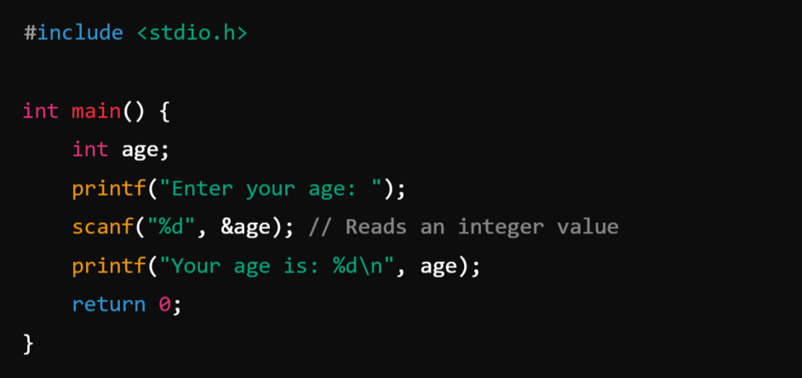
Example:

Slide 93
Output: printf() prints formatted output.
Syntax:
format_specifiers: Specifies the type of output (e.g., %d for integers, %f for floating-point numbers, etc.).
The variables are inserted into the output string based on the format specifiers.

Slide 94
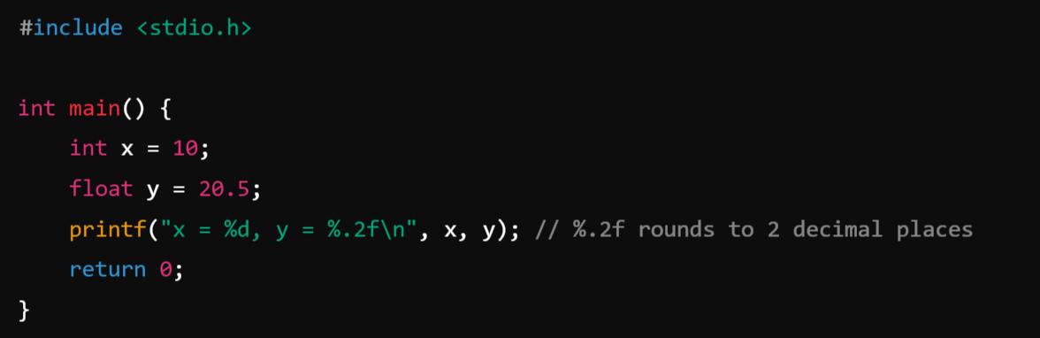
Example:

Slide 95
Format Specifiers:
Specifier | Type | Example
%d | Integer (decimal) | 10
%f | Floating-point number | 3.1415
%.nf | Float with n decimals | %.2f → 3.14
%c | Single character | 'A'
%s | String (char array) | "Hello"
%x | Hexadecimal integer | 0x1A

Slide 96
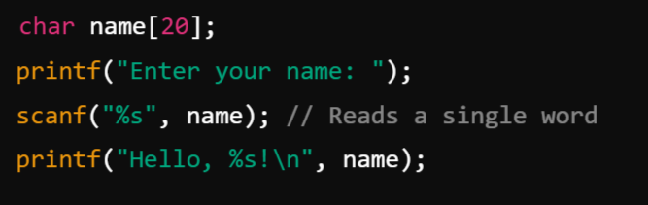
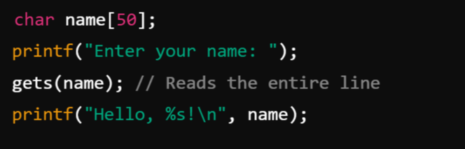
Advanced I/O: Reading Strings:
Using scanf():
Using gets() (less safe, deprecated):

Slide 97
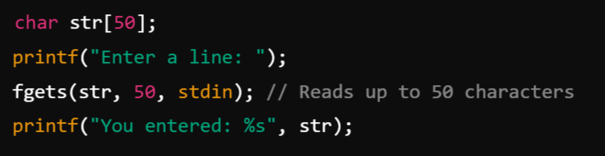
3. Reading Entire Lines: Use fgets() to read entire lines safely

Slide 98
Assignment Statements:
In C, assignment statements are used to assign a value to a variable. These statements involve the assignment operator = or a compound assignment operator (like +=, -=, *=, etc.).
Types of Assignment Statements:
Basic Assignment Statement
Multiple Assignments
Compound Assignment Operators

Slide 99

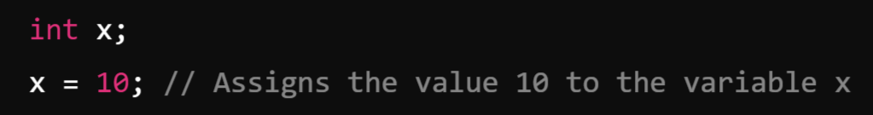
1. Basic Assignment Statement:
The simplest assignment is done using the = operator, which assigns the right-hand side (RHS) value to the left-hand side (LHS) variable.
Syntax:
Example:

Slide 100

2. Multiple Assignments:
You can chain assignment statements to assign the same value to multiple variables.
Example:
3. Compound Assignment Operators:
Compound assignment operators perform an operation and assign the result to the variable in one step. They are shorthand for combining an arithmetic or bitwise operation with an assignment.

Slide 101
Operator | Meaning | Example
+= | Add and assign | x += 5; (same as x = x + 5;)
-= | Subtract and assign | x -= 3; (same as x = x - 3;)
*= | Multiply and assign | x *= 2; (same as x = x * 2;)
/= | Divide and assign | x /= 4; (same as x = x / 4;)
%= | Modulus and assign | x %= 2; (same as x = x % 2;)
&= | Bitwise AND and assign | x &= 1; (same as x = x & 1;)
` | =` | Bitwise OR and assign
^= | Bitwise XOR and assign | x ^= 3; (same as x = x ^ 3;)
<<= | Left shift and assign | x <<= 1; (same as x = x << 1;)
>>= | Right shift and assign | x >>= 1; (same as x = x >> 1;)

Slide 102

Example:

Slide 103
Decision making statements:
In C, decision-making statements control the flow of execution in a program based on certain conditions. They allow the program to make decisions and execute specific blocks of code depending on whether a condition evaluates to true or false.
Main decision-making statements:
if Statement
if-else Statement
if-else-if Ladder
Nested if Statement
switch Statement

Slide 104


1. if Statement
The if statement is used to execute a block of code only if a specified condition is true.
The if statement evaluates a condition (a Boolean expression). If the condition is true, the block of code within the if statement is executed. If the condition is false, the block is skipped.
Syntax:
Example:

Slide 105

Simple If Flow Chart

Slide 106


2. if-else statement:
The if-else statement provides two blocks of code: one that executes if the condition is true and another that executes if the condition is false.
Syntax:
Example:

Slide 107

if-else Flow Chart

Slide 108

3. if-else-if ladder:
The if-else-if ladder allows for multiple conditions to be evaluated sequentially. The first condition that evaluates to true will have its corresponding block executed, and the rest of the ladder will be skipped. If none of the conditions are true, the else block (if present) will be executed.
Syntax:

Slide 109

Example:

Slide 110

4. Nested if statement:
Nested if statements allow an if statement to be placed inside another if statement. This allows for more complex decision-making processes where multiple conditions must be true for a block of code to execute.
Syntax:

Slide 111

Example:

Slide 112

5. Switch statement:
The switch statement evaluates an expression and compares it to a list of case values. When a match is found, the corresponding block of code is executed. The break statement is used to exit the switch block after the matched case has been executed. If no match is found, the default block (if present) is executed. The switch statement is often used as an alternative to the if-else-if ladder for better readability and performance when dealing with multiple possible values of an expression.
Syntax:

Slide 113

Example:

Slide 114
2. Loop Statements:
In C, looping statements are used to execute a block of code repeatedly until a specified condition is met or no longer holds true
Looping statements allow the execution of a block of code repeatedly based on a condition. They are essential for tasks that require iteration, such as processing elements in an array or repeatedly performing an operation until a certain condition is met.
Looping Statements are:
for loop
while loop (Entry Controlled Loop)
do-while loop (Exit Controlled Loop)

Slide 115


1. for loop:
The for loop provides a concise way of writing the loop structure. It is used when the number of iterations is known advance or beforehand.
Syntax:
Example:

Slide 116

for Loop Flow Chart:

Slide 117


2. while loop:
The while loop continually executes a block of code as long as a specified condition is true. The condition is checked before the execution of the loop body, making it a pre-test loop.
The while loop is used when the number of iterations is not known in advance, but the condition is checked before the loop body executes.
Syntax & Example:

Slide 118


Slide 119


3. do-while loop:
The do-while loop is similar to the while loop, but the condition is checked after the loop body is executed. This ensures that the loop runs at least once.
Syntax & Example:

Slide 120

do-while Loop Flow Chart

Slide 121

PRE-PROCESSOR DIRECTIVES:
In C, preprocessor directives are instructions given to the C preprocessor before the actual compilation of the code begins. They are used to instruct the compiler to perform specific operations like including files, defining constants, conditional compilation, etc. Preprocessor directives start with a # symbol and are executed before the actual code compilation phase.
The C preprocessor is a micro processor that is used by compiler to transform your code before compilation. It is called micro preprocessor because it allows us to add macros. Preprocessor directives are executed before compilation.

Slide 122
Common Preprocessor Directives in C:
File Inclusion: #include
Macro Definitions: #define
Conditional Compilation: #ifdef, #ifndef, #if, #else, #elif, #endif
Line Control: #line
Error Directive: #error
Pragma Directive: #pragma

Slide 123

File Inclusion (#include): Used to include header files in a program.
Syntax:
Example:

Slide 124


2. Macro Definitions (#define):
Used to define constants or macros. Macros are pieces of code that are replaced by their defined values or expressions during preprocessing.
Syntax:
Example:
PI is a constant.
SQUARE(x) is a macro function.

Slide 125

3. Conditional Compilation: Used to compile code conditionally based on certain conditions.
Directives: #ifdef, #ifndef, #if, #else, #elif, #endif
Syntax:

Slide 126

Example:

Slide 127


4. Line Control (#line): Used to modify the line number and file name for compiler error messages.
Syntax:
Example:
The __LINE__ and __FILE__ macros use the custom values set by #line.

Slide 128


5. Error Directive (#error): Used to generate a compilation error with a custom message.
Syntax:
Example:

Slide 129



6. Pragma Directive (#pragma):
Used to give specific instructions to the compiler, such as suppressing warnings or enabling optimizations. Its behavior is compiler-specific.
Syntax:
Example (GCC): Output:
The #pragma directive outputs a custom message during compilation.

Slide 130
Compilation Process:
The compilation process in C involves converting the human-readable source code into machine-readable code (executable program). This process is handled by the C compiler and includes multiple stages.
Stages of Compilation
Preprocessing
Compilation
Assembly
Linking

Slide 131

w

Slide 132
1. Preprocessing:
The first stage processes all preprocessor directives (lines starting with #) and generates an intermediate file without these directives.
Key Operations:
Expands macros (#define).
Includes header files (#include).
Handles conditional compilation (#ifdef, #ifndef).
Removes comments from the code.
Input: example.c
Output: Preprocessed file (example.i).

Slide 133


Example:
After preprocessing:

Slide 134

2. Compilation:
The second stage converts the preprocessed code into assembly language. The compiler translates C code into a low-level, human-readable format that corresponds to the processor's instruction set.
Compiler compiles the filename.i and produce an intermediate compiled output file filename.s which is in assembly-level instructions.
Example:
Input: Preprocessed file (example.i).
Output: Assembly file (example.s).
Example Assembly Code:

Slide 135
3. Assembly:
The third stage converts the assembly code into machine code (binary format) using an assembler. The result is an object file, which contains machine code but is not yet executable.
In this phase the filename.s is taken as input and turned into filename.o by the assembler. This file contains machine-level instructions. At this phase, only existing code is converted into machine language, and the function calls like printf() are not resolved.
Example:
Input: Assembly file (example.s).
Output: Object file (example.o).
Key Points:
The object file contains machine code and placeholders for unresolved references (e.g., functions or variables in external files).

Slide 136
4. Linking:
The final stage combines all object files, libraries, and external references to create a complete executable file. The linker resolves references to external functions or variables (e.g., functions from the standard library like printf).
Linker knows where all these functions are implemented. Linker does some extra work also, it adds some extra code to our program which is required when the program starts and ends.
Example:
Input: Object file(s) (example.o).
Output: Executable file (example or example.exe).
Key Operations:
Combines object files and libraries.
Resolves references to external functions.
Produces the final executable.

Slide 137
Applications of C Language:
The C language is a versatile, efficient, and powerful programming language widely used in various domains due to its speed, low-level access to hardware, and portability.

Slide 138
1. Operating System Development
C is the foundation for many operating systems because of its efficiency and low-level features. It provides access to system-level resources and hardware, which is crucial for OS development.
Examples:
Unix and Linux are written primarily in C.
Parts of Microsoft Windows are also developed in C.
2. Embedded Systems
C is extensively used in embedded systems programming due to its ability to interact directly with hardware and provide high performance with minimal overhead.
Examples:
Microcontroller programming for IoT devices.
Firmware for devices like washing machines, routers, and medical equipment.

Slide 139
3. System Programming
C is used to develop system-level software like device drivers, file systems, and network protocols.
Examples:
Device drivers for hardware components.
File management systems for organizing data storage.
4. Game Development
C's speed and efficiency make it a popular choice for developing games where performance is critical.
Examples:
Game engines like Unreal Engine (originally written in C).
Graphics libraries like OpenGL.

Slide 140
5. Database Management Systems
Many database engines are built using C due to its performance and memory management capabilities.
Examples:
MySQL (written in C).
Oracle Database (core components written in C).
6. Compiler Development
C is frequently used to create compilers for other programming languages because of its ability to generate efficient machine code.
Examples:
The GCC (GNU Compiler Collection) is written in C and C++.
Clang (a compiler for C-like languages) is partly developed in C.

Slide 141
7. Scientific Computing
C is used in scientific research and simulations because of its efficiency in handling mathematical computations and large datasets.
Examples:
Numerical computation libraries.
Simulations for physics, chemistry, and biology.
8. High-Performance Applications
C is chosen for applications that require high performance and low latency, such as stock trading systems and real-time systems.
Examples:
High-frequency trading platforms.
Real-time data analytics engines.

Slide 142
9. Language Interpreters and Virtual Machines
C is used to implement interpreters and virtual machines for other programming languages.
Examples:
The Python interpreter (CPython) is written in C.
The Java Virtual Machine (JVM) has components developed in C.
10. Desktop and GUI Applications
Although less common today due to modern GUI libraries, C has historically been used for desktop applications that require high performance.
Examples:
Early text editors.
Image processing tools.

Slide 143
Why Use C for These Applications?
Portability: Programs written in C can be easily adapted to different platforms.
Performance: Direct access to memory and hardware makes it efficient.
Simplicity: Small, concise syntax ideal for system-level programming.
Wide Adoption: A vast ecosystem of libraries and tools.
Control: Provides control over memory management (e.g., malloc, free).

Slide 144
Module-1: BASICS OF C PROGRAMMING :
Introduction to programming paradigms: Applications of C Language, Structure of C program
C programming: Data Types, Constants, Enumeration Constants, Keywords.
Operators: Precedence and Associativity, Expressions, Input/Output statements, Assignment statements, Decision making statements, Switch statement, Looping statements Preprocessor directives, Compilation process.

